Slide 1


Can Code Measure Experience?
Juliana, Maya
Uses & Constraints of Computational Textual Analysis

Slide 2
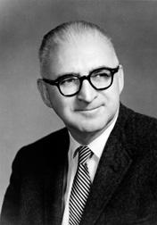
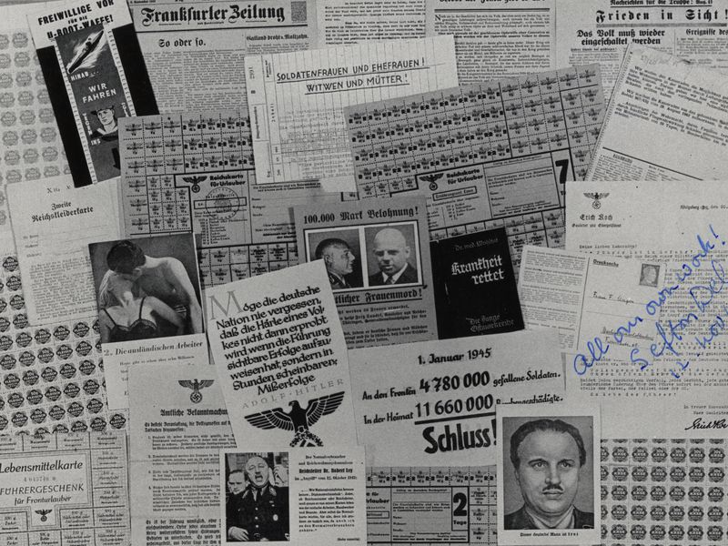
Harold Lasswell
political scientist & communications theorist
03
Legacy of Methods
01
02
Wartime Communications
03
Preparatory Propaganda
Shifted from previous analytics - not just qualitative measurements by unit
Context of speaker, audience & analyst
Lasswell’s Model of Communication
WWI, WWII propaganda
FCC analysts came up with new methods + procedures
Age of mass media: newspapers, speeches, ads, posters, radio, tv, etc.
Big Data: looked at information reliability
Shifts in moral, cultural beliefs, relations
Able to predict military actions to the date through propaganda

Slide 3
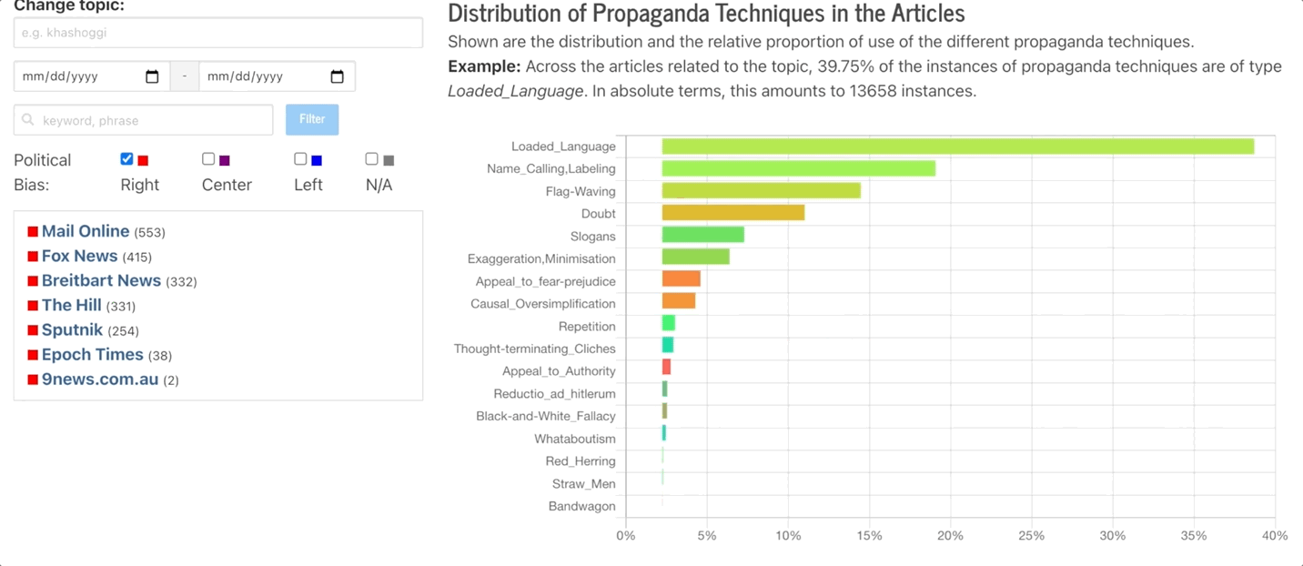
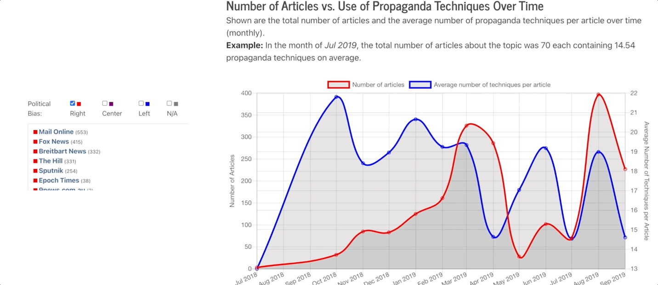
Resource for text analysis at
https://www.tanbih.org/prta

Slide 4
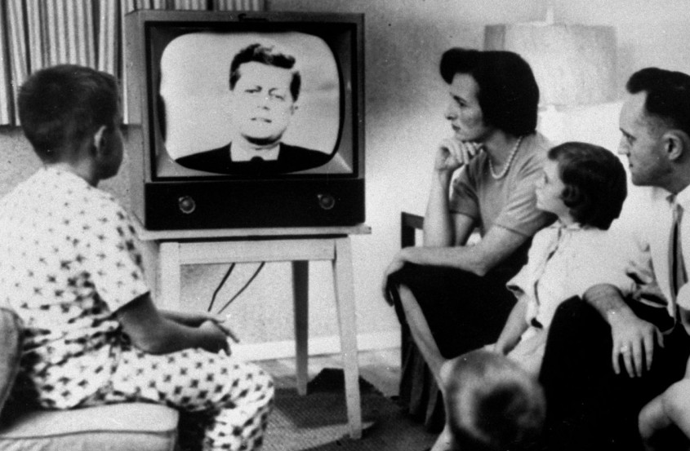
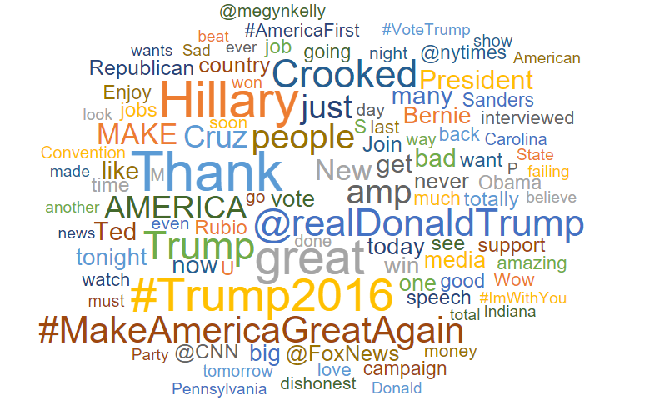
01
02
03
Model of Communication
Source of Message
Message
The Medium of Media
Who says what? What level of power do they hold?
What do they say? How do they say it?
In which channel is the message given through? How accessible is it?

Slide 5


04
05
The Receiver
Effect
Who is the audience? What is their individual and group culture and identity?
With what effect does the message have? What emotions does it give?

Slide 6
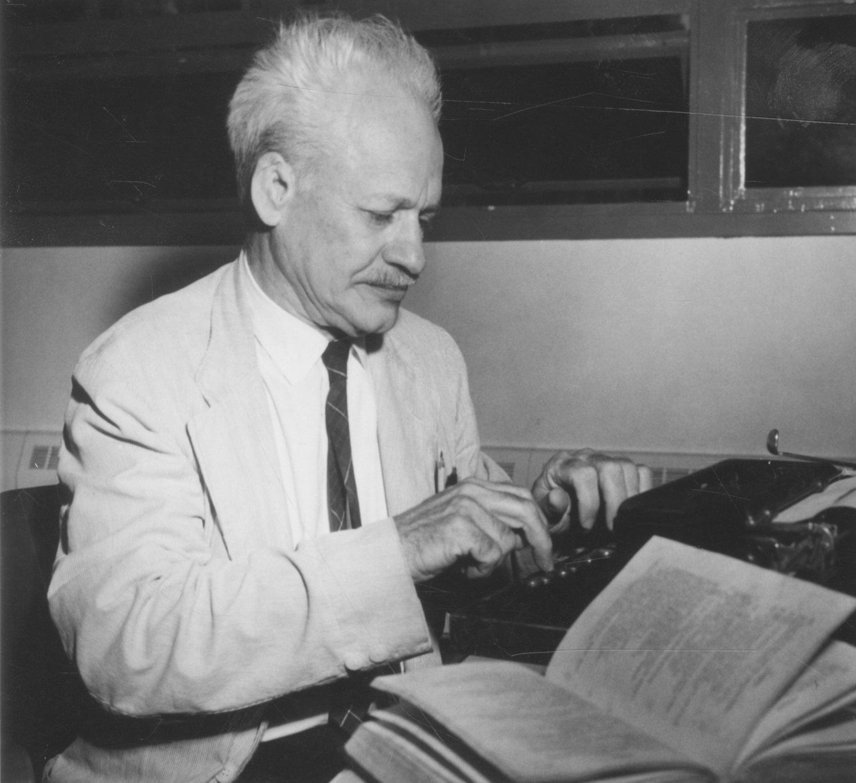
Kenneth Burke
philosopher & communications theorist
03
Solutions
01
02
Early Goals
03
Limitations of Distant Reading
Poetic Interpretation:
What researchers call “computational hermeneutics”
Named Entity Recognition and Semantic Grammar Analysis
Semantic Interpretation:
Find indisputable evidence. Clear and unambiguous.
Shallow reading that specifies and identifies the precise/objective data in a text.
Lost of subtleties of expression.
Erasure of the complexities and the nuanced meanings.
Makes it less relevant for scholars interested in deeper analysis.
Notes:
In short, content analysis, from the start, has been focused on the goal of capturing a set of primary ideas, usually those constituting the manifest meaning of a textual corpus, which is to say, that which is expressed in plain view and about which there is little or no dispute. The pursuit of this primary goal has meant that the subtleties of expression, the complexities of phrasing and the more nuanced meanings of textual corpora are discarded, with only the best, most efficient units of meaning being extracted and preserved as data.

Slide 7
Close Reading and the US National Security
Researchers analyzed 11 National Strategic Security; they focused on its rhetoric method.
They took into consideration five terms that Burke considers crucial in any close readings:
what was done (act)
when or where it was done (scene)
who did it (agent)
how he did it (agency)
and why (purpose)
They used Named Entity Recognition (NER) to identify different agents and semantic grammar analysis to identify the actions taken by these agents.
Notes:
We are trying to say that scientists are trying to bring humanistic elements to it.. How transforming digital humanities into an even more humanistic field would bring in our biases in? The more algorithmic a program is - the less biased it is.
We also intend to discuss how internal biases affect computational culture and the resulting interpretations are resulting effects of the computational designs created post World War II. It is important to consider this of these systems: who created and now uses them, in what historical context were they used, and who benefits from them? By incorporating this idea, we will be able to further understand how accurate the results are. .

Slide 8
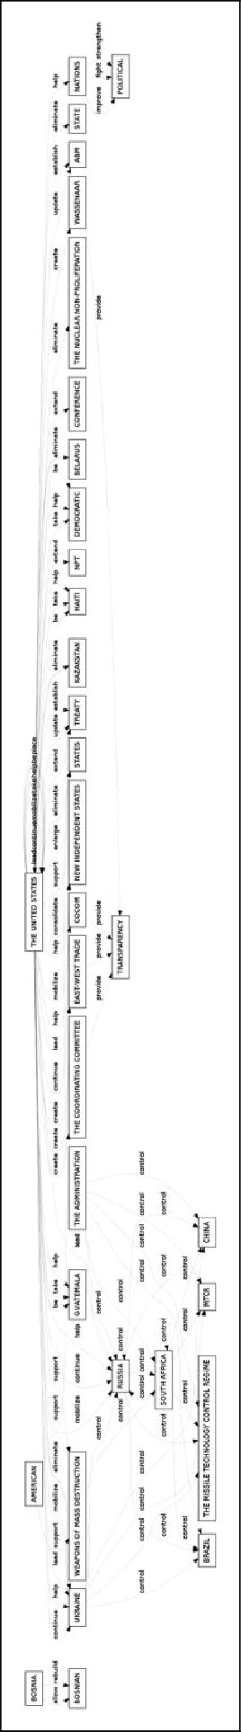
Close Reading and the US National Security
With this approach, the team capture Clinton administration’s concerns with ‘controlling’ the agents of terror in the 1990s, and the Bush administration’s focus on ‘removing’, ‘commanding,’ ‘building,’ and ‘expanding’ in the 2000s.
By focusing in on what Burke describes as the “grammar of motives” they were able to use automated methods to mimic a particular style of close reading.
Notes:
We are trying to say that scientists are trying to bring humanistic elements to it.. How transforming digital humanities into an even more humanistic field would bring in our biases in? The more algorithmic a program is - the less biased it is.
We also intend to discuss how internal biases affect computational culture and the resulting interpretations are resulting effects of the computational designs created post World War II. It is important to consider this of these systems: who created and now uses them, in what historical context were they used, and who benefits from them? By incorporating this idea, we will be able to further understand how accurate the results are. .

Slide 9
Algorithmic Bias
“...found age-related bias
among popular sentiment tools and commonly-used word embeddings. We reduced bias by creating a classifier built on modified training data.”
“For almost all topics, training set compositions and data set sizes, female-authored reviews are more accurately classified than male-authored reviews”
Proceedings of the 2018 chi conference on human factors in computing systems
Research Institute in Information and Language Processing
Online targeted advert placement
software can “tend to deliver high-paying job adverts to males or negative adverts (e.g., for prison record searches) in response to
ethnic minority name searches”
Association for Computing Machinery & 28th Computer Security Foundations Symposium
Notes:
We are trying to say that scientists are trying to bring humanistic elements to it.. How transforming digital humanities into an even more humanistic field would bring in our biases in? The more algorithmic a program is - the less biased it is.
How internal biases affect computational culture and the resulting interpretations are resulting effects of the computational designs created post World War II. It is important to consider this of these systems: who created and now uses them, in what historical context were they used, and who benefits from them? By incorporating this idea, we will be able to further understand how accurate the results are. .
Biases - can algorithms be fully apart from internalized biases / the cultures they are in? If we can’t work on the problem in the field how can you address it in the code?

Slide 10
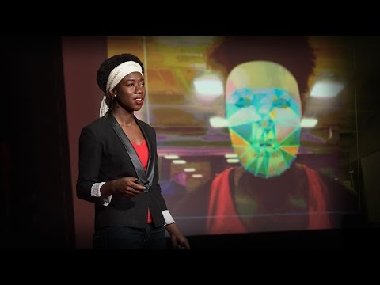
How I'm fighting bias in algorithms Joy Buolamwini
Notes:
MIT grad student who studies the social impact technology and inclusion

Slide 11
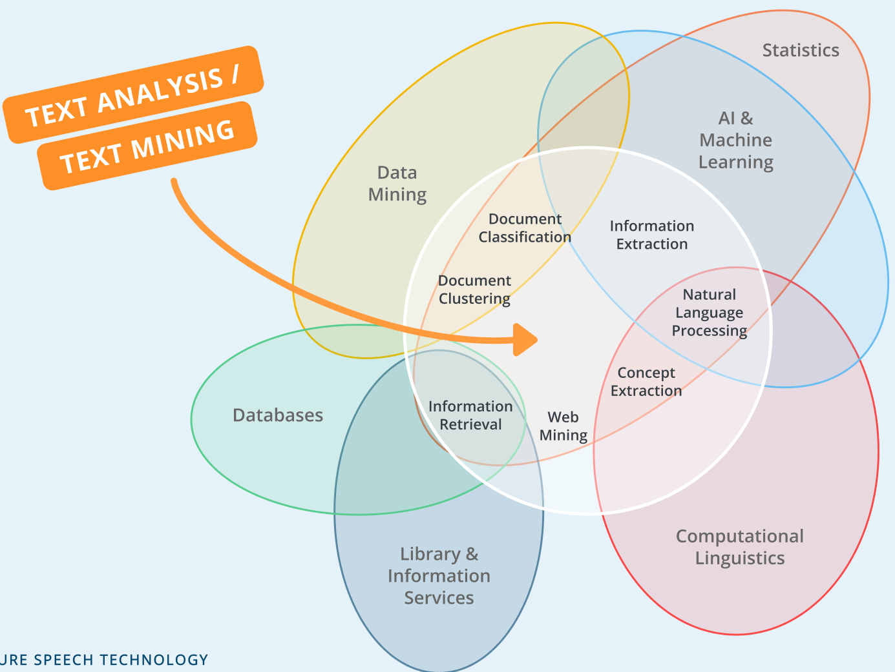
Last Thoughts & Questions
Notes:
We are trying to say that scientists are trying to bring humanistic elements to it.. How transforming digital humanities into an even more humanistic field would bring in our biases in? The more algorithmic a program is - the less biased it is.

Slide 12
Works Cited
Mohr, J. W., Wagner-Pacifici, R., & Breiger, R. L. (2015). Toward a computational hermeneutics. Big Data
& Society, 2(2), 2053951715613809.
Grimmer, J. (2015). We are all social scientists now: How big data, machine learning, and causal inference
work together. PS, Political Science & Politics, 48(1), 80.
McPherson, T. (2012). Why are the digital humanities so white? Or thinking the histories of race and
computation. Debates in the digital humanities, 1, 139-160.
Owens, T. (2011). Defining data for humanists: Text, artifact, information or evidence. Journal of Digital
Humanities, 1(1), 1-1.
Díaz, M., Johnson, I., Lazar, A., Piper, A. M., & Gergle, D. (2018, April). Addressing age-related bias in
sentiment analysis. In Proceedings of the 2018 chi conference on human factors in computing
systems (pp. 1-14).
Thelwall, M. (2018). Gender bias in sentiment analysis. Online Information Review.

